Slide 1


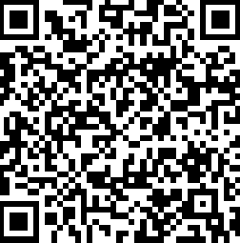
Extended Induction Student Feedback
Learning & Wellbeing
offers you a chance to
WIN 1 of 4
Amazon vouchers
To enter the draw or for more info, visit: www.surveymonkey.co.uk/r/5SJB88F
or scan the QR code

