Slide 1


the New RVC Termly Student Survey… launches Thursday 15 October
Complete your survey to let the College know:
How you are getting on?
What could we improve before the end of term?
What is working well?
1 student survey each term!
Look out
for the colleges response to the results on Learn

Slide 2

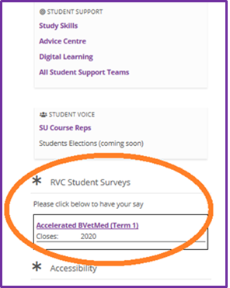
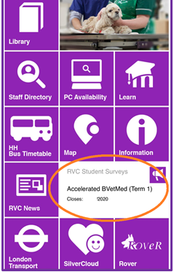
How to Access your ‘RVC Termly Survey’...
2. LEARN
3. RVC APP
1. SURVEY EMAIL

